Slide 1
MNIST Digit Classification Project
Prerequisites
Numpy->used for working with numerical data. It provides a powerful object known as an Array. With Arrays, we can perform mathematical operations on multiple values in the Arrays at the same time, and also perform operations between different Arrays, similar to matrix operations.
TensorFlow-> is a Python-friendly open source library for numerical computation that makes machine learning faster and easier. TensorFlow can train and run deep neural networks for handwritten digit classification, image recognition, word embeddings, recurrent neural networks, sequence-to-sequence models for machine translation, natural language processing
Keras-> open-source neural-network library written in Python capable of running on top of Tensor Flow. It contains many datasets.
Pillow-> is a Python Imaging Library (PIL), which adds support for opening, manipulating, and saving images.

Slide 2
Steps to implement the MNIST Digit Classification Project to recognize handwritten digits:
Import the libraries and load the MNIST dataset
Data Preprocess and Normalize
Create the model
Train the model
Evaluate the model
Create GUI to predict digits

Slide 3
Step 1:Import the libraries and load the MNIST dataset
MNIST-> The MNIST dataset contains 60,000 training images of handwritten digits from zero to nine and 10,000 images for testing. So, the MNIST dataset has 10 different classes. The handwritten digits images are represented as a 28×28 matrix where each cell contains grayscale pixel value.
Sequential->The simplest model which is a linear stack of Layers. You can create a Sequential model and define all of the layers in the constructor, for example: from keras.models import Sequential
Dense->layer represents a matrix vector multiplication. A dense layer is used to change the dimensions of your vector.

Slide 4
Dropout->Dropout is a technique used to prevent a model from over fitting. data. The dropout rate is set to 20%, meaning one in 5 inputs will be randomly excluded from each update cycle.
Over fitting refers to a model that models the training data too well. Over fitting happens when a model learns the detail and noise in the training data to the extent that it negatively impacts the performance of the model on new data.
Flatten-> is used to flatten the input. For example, if flatten is applied to layer having input shape as (batch size, 2,2), then the output shape of the layer will be (batch size, 4)
Conv2D-> With Conv2D, two dimensions are used, so the convolution operates on the two axis defining the data.

Slide 5
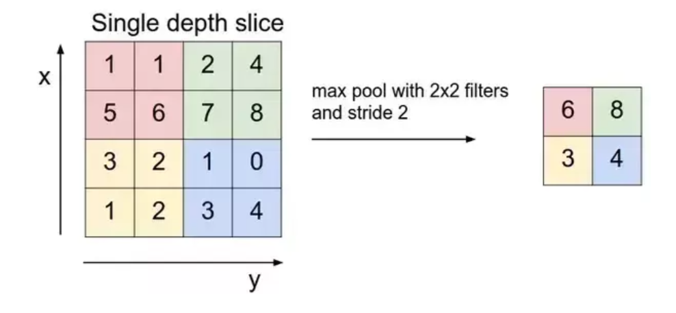
Max pooling-> is a sample-based discretization process. The objective is to down-sample an input representation (image, hidden-layer output matrix, etc.), reducing its dimensionality

Slide 6
Backend->You can import the backend module via:
from keras import backend as K
The code below instantiates an input placeholder.
The mnist.load_data()-> method returns us the training data, its labels and also the testing data and its labels.
(x_train, y_train), (x_test, y_test) = mnist.load_data()
When we load the dataset below, X_train and X_test will contain the images, and y_train and y_test will contain the digits that those images represent.

Slide 7
Step2:Data Preprocess and Normalize
We will plot the first image in our dataset and check its size using the ‘shape’ function which is 28*28.
We need to reshape our dataset inputs (X_train and X_test) to the shape that our model expects when we train the model. The first number is the number of images (60,000 for X_train and 10,000 for X_test). Then comes the shape of each image (28x28). The last number is 1, which signifies that the images are greyscale. Greyscale means black and white image.
y_train = keras.utils.to_categorical(y_train, 10) #Here 10 is number of classes i.e. 0 to 9 there are 10 numbers
y_test = keras.utils.to_categorical(y_test, 10)
(We need to ‘one-hot-encode’ our target variable. This means that a column will be created for each output category and a binary variable is inputted for each category. For example, we saw that the first image in the dataset is a 5. This means that the sixth number in our array will have a 1 and the rest of the array will be filled with 0).

Slide 8
x_train /= 255
x_test /= 255
(When using neural network models, It is good to perform some scaling of input values to normalize the pixel values to the range 0 and 1 by dividing each value by the maximum value (Note: The pixel values are gray scale between 0 and 255).
An epoch refers to one cycle through the full training dataset.

Slide 9
Create GUI to predict digits
load_model->Load A Model From File.
tkinter-> tkinter package is used to create GUI applications. It provides common GUI elements such as buttons, menus, entry fields and display areas.
Tk->Tk() is the method used to create main window of an application.
Win32gui->The win32gui. pyd is an executable file on your computer's hard drive. This file contains machine code. If you start the software PyWin32 on your PC, the commands contained in win32gui. pyd will be executed on your PC.
PIL->Python Imaging Library > is a Python Imaging Library (PIL), which adds support for opening, manipulating, and saving images.

Slide 10
Then we create the App class which is responsible for building the GUI for our app. We create a canvas where we can draw by capturing the mouse event and with a button, we trigger the predict_digit() function and display the results.
The ImageGrab module can be used to copy the contents of the screen or the clipboard to a PIL image memory. PIL. ImageGrab. grab() method takes a snapshot of the screen.
Here, we load the saved model for recognition of the handwritten digit by providing the model path.
Canvas is a widget for drawing graphics. It can be used to create custom widgets so we can draw anything we like inside it. In our application we will use the widget to draw the digit (single as well as multiple).
A Button usually maps directly onto a user action. In our application we use two buttons named as “Recognize Digit” and “Clear Widget”. when the user clicks on a button, it triggers the functions as assigned.

Slide 11
“<B1-Motion>” indicates that the mouse was moved while the left button was pressed.
clear_all ()function is used to clear the canvas. Note that items added to the canvas are kept until you remove them. In our application we will use the delete() method to clear the previous drawn digits on canvas so we can draw new one.
draw_lines() function is used to draw a line on the canvas.
The next block contains single function called classify_handwriting().
we will use ImageGrab module to copy the contents of the screen or the clipboard to a PIL (Python Imaging Library) image memory. Basically, it takes a snapshot of the screen.

Slide 12
We have created a function predict_digit() that takes the image as input and then uses the trained model to predict the digit.
Then we create the App class which is responsible for building the GUI for our app. We create a canvas where we can draw by capturing the mouse event and with a button, we trigger the predict_digit() function and display the results.
we execute the mainloop() method on the main window to run our application. This method will loop forever, waiting for events from the user, until the user exits the program.

